Slide 1



TEAM 10
Phish'N'Chips
Intelligent Threat Detection System

Slide 2
The Problem
Phishing: A Major Cybersecurity Threat
Phishing attacks are prevalent and devastating in the cybersecurity landscape. Statistics show that up to 95% of data breaches involve phishing, with an average cost per breach of $4.88 million. Current tools for security analysts are lacking, leading to slow manual URL validation.

Slide 3
Market Potential
Phishing Defense Automation
The demand for automated phishing defense solutions is growing among SOC teams, cybersecurity analysts, and organizations. With the cybersecurity market projected to reach $345 billion by 2026, addressing this need is essential.

Slide 4
Our Solution Overview
Intelligent Threat Detection System
Drools Engine
Prolog Integration
User Interface
The Drools Engine employs rule-based analysis to efficiently evaluate potential threats, utilizing an extensive library of security rules that adapt to emerging phishing tactics, enhancing detection accuracy and speed.
By leveraging Prolog for logical inference, our system can analyze complex relationships within data, enabling it to identify sophisticated phishing attempts that traditional methods often overlook, improving overall system intelligence.
The user interface provides real-time threat visualization, allowing security analysts to monitor detected threats dynamically. This feature enhances situational awareness and facilitates rapid response to potential phishing attacks.

Slide 5
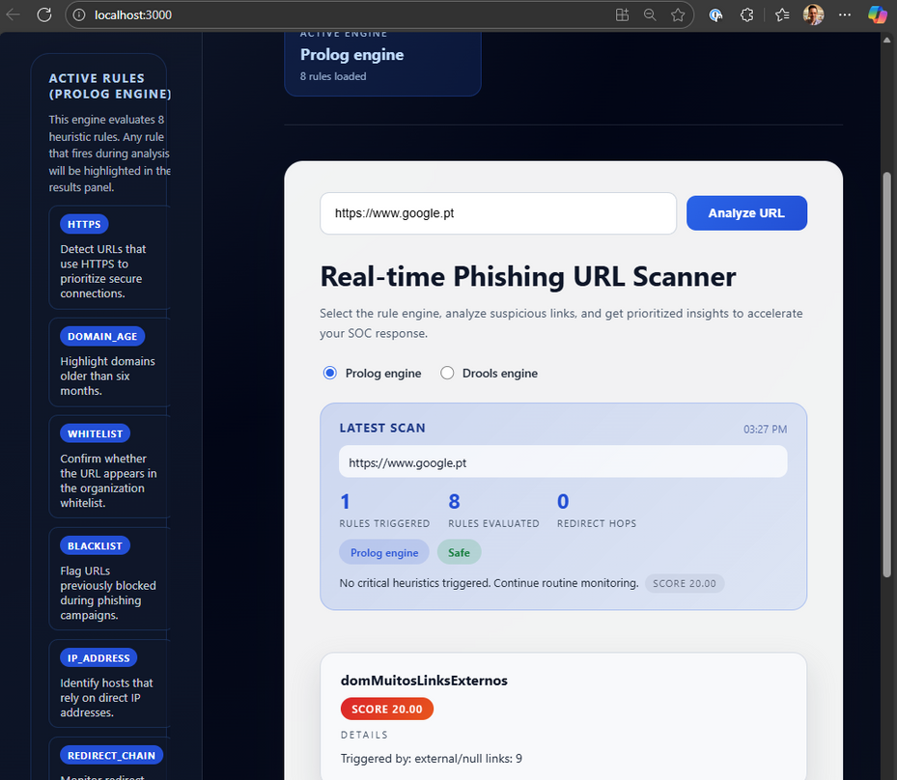
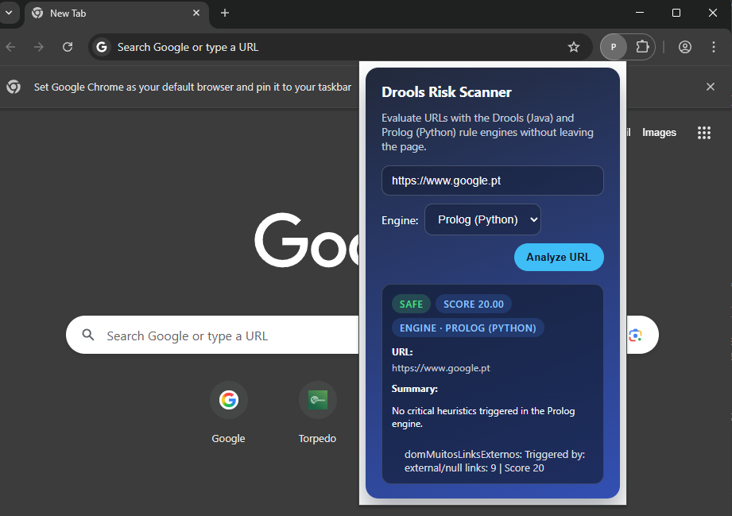
Our Solution Overview
Intelligent Threat Detection System

Slide 6




Team 10
Arsénio Ferraz
Entrepreneur, Co-CEO
Bruno Camarneiro
1250422@isep.ipp.pt
1010137@isep.ipp.pt
César Vieira
Rui Soares
1241523@isep.ipp.pt
1221283@isep.ipp.pt

Slide 7
Team 10
THANK YOU!
Protecting users through rule-based intelligence – Phish-n-Chips, your defense against phishing.
For more details, visit our blog at Phish-N-Chips25.github.io
– there you will find demos, source code, and additional materials

